Slide 1
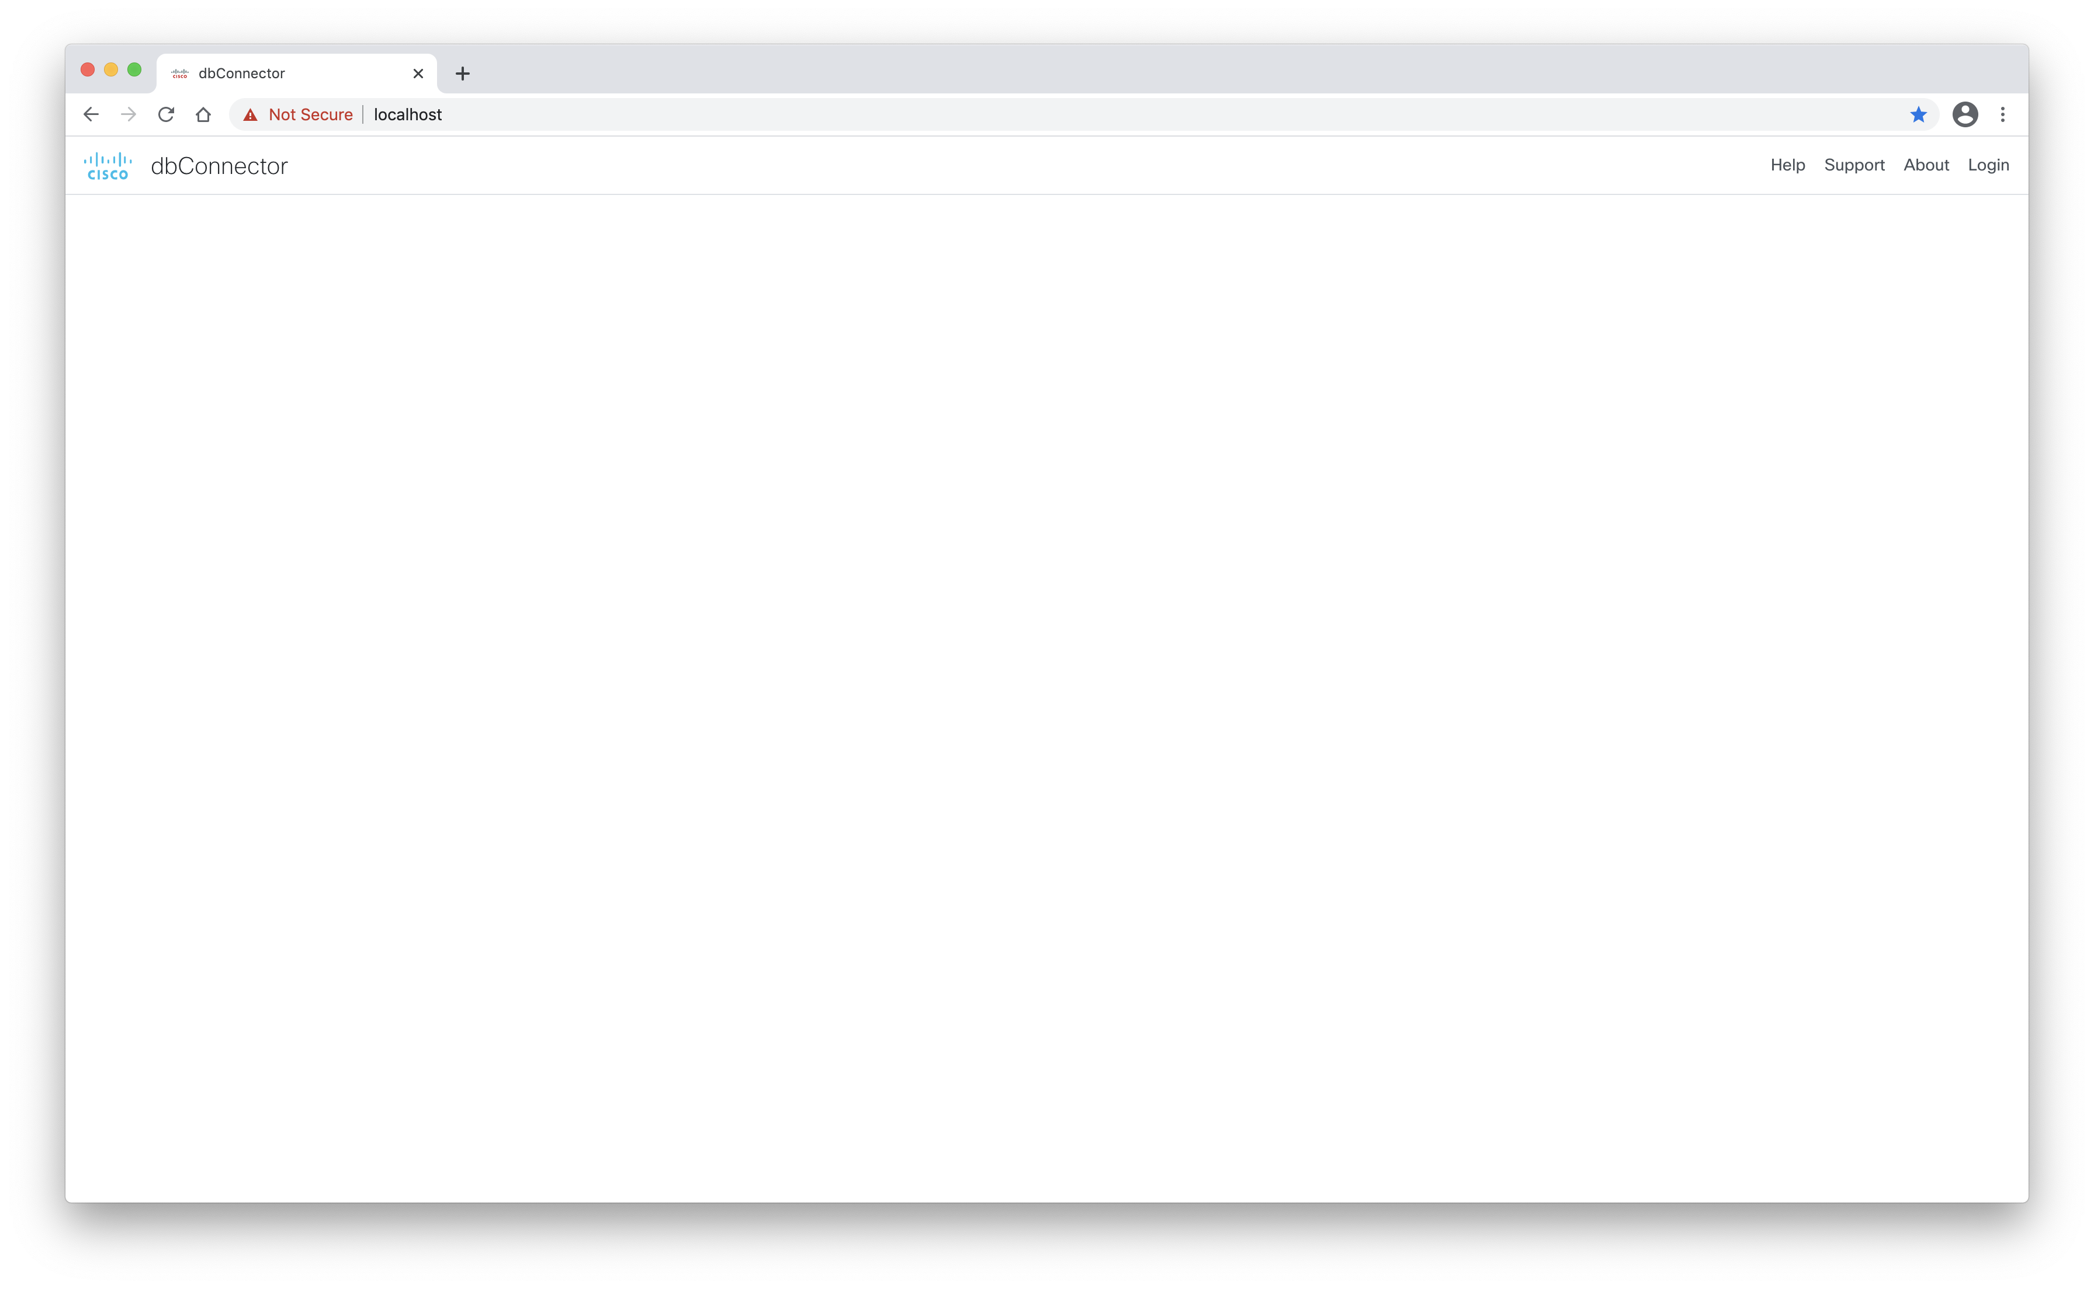
dbConnector Home Page
Click to login

Slide 2
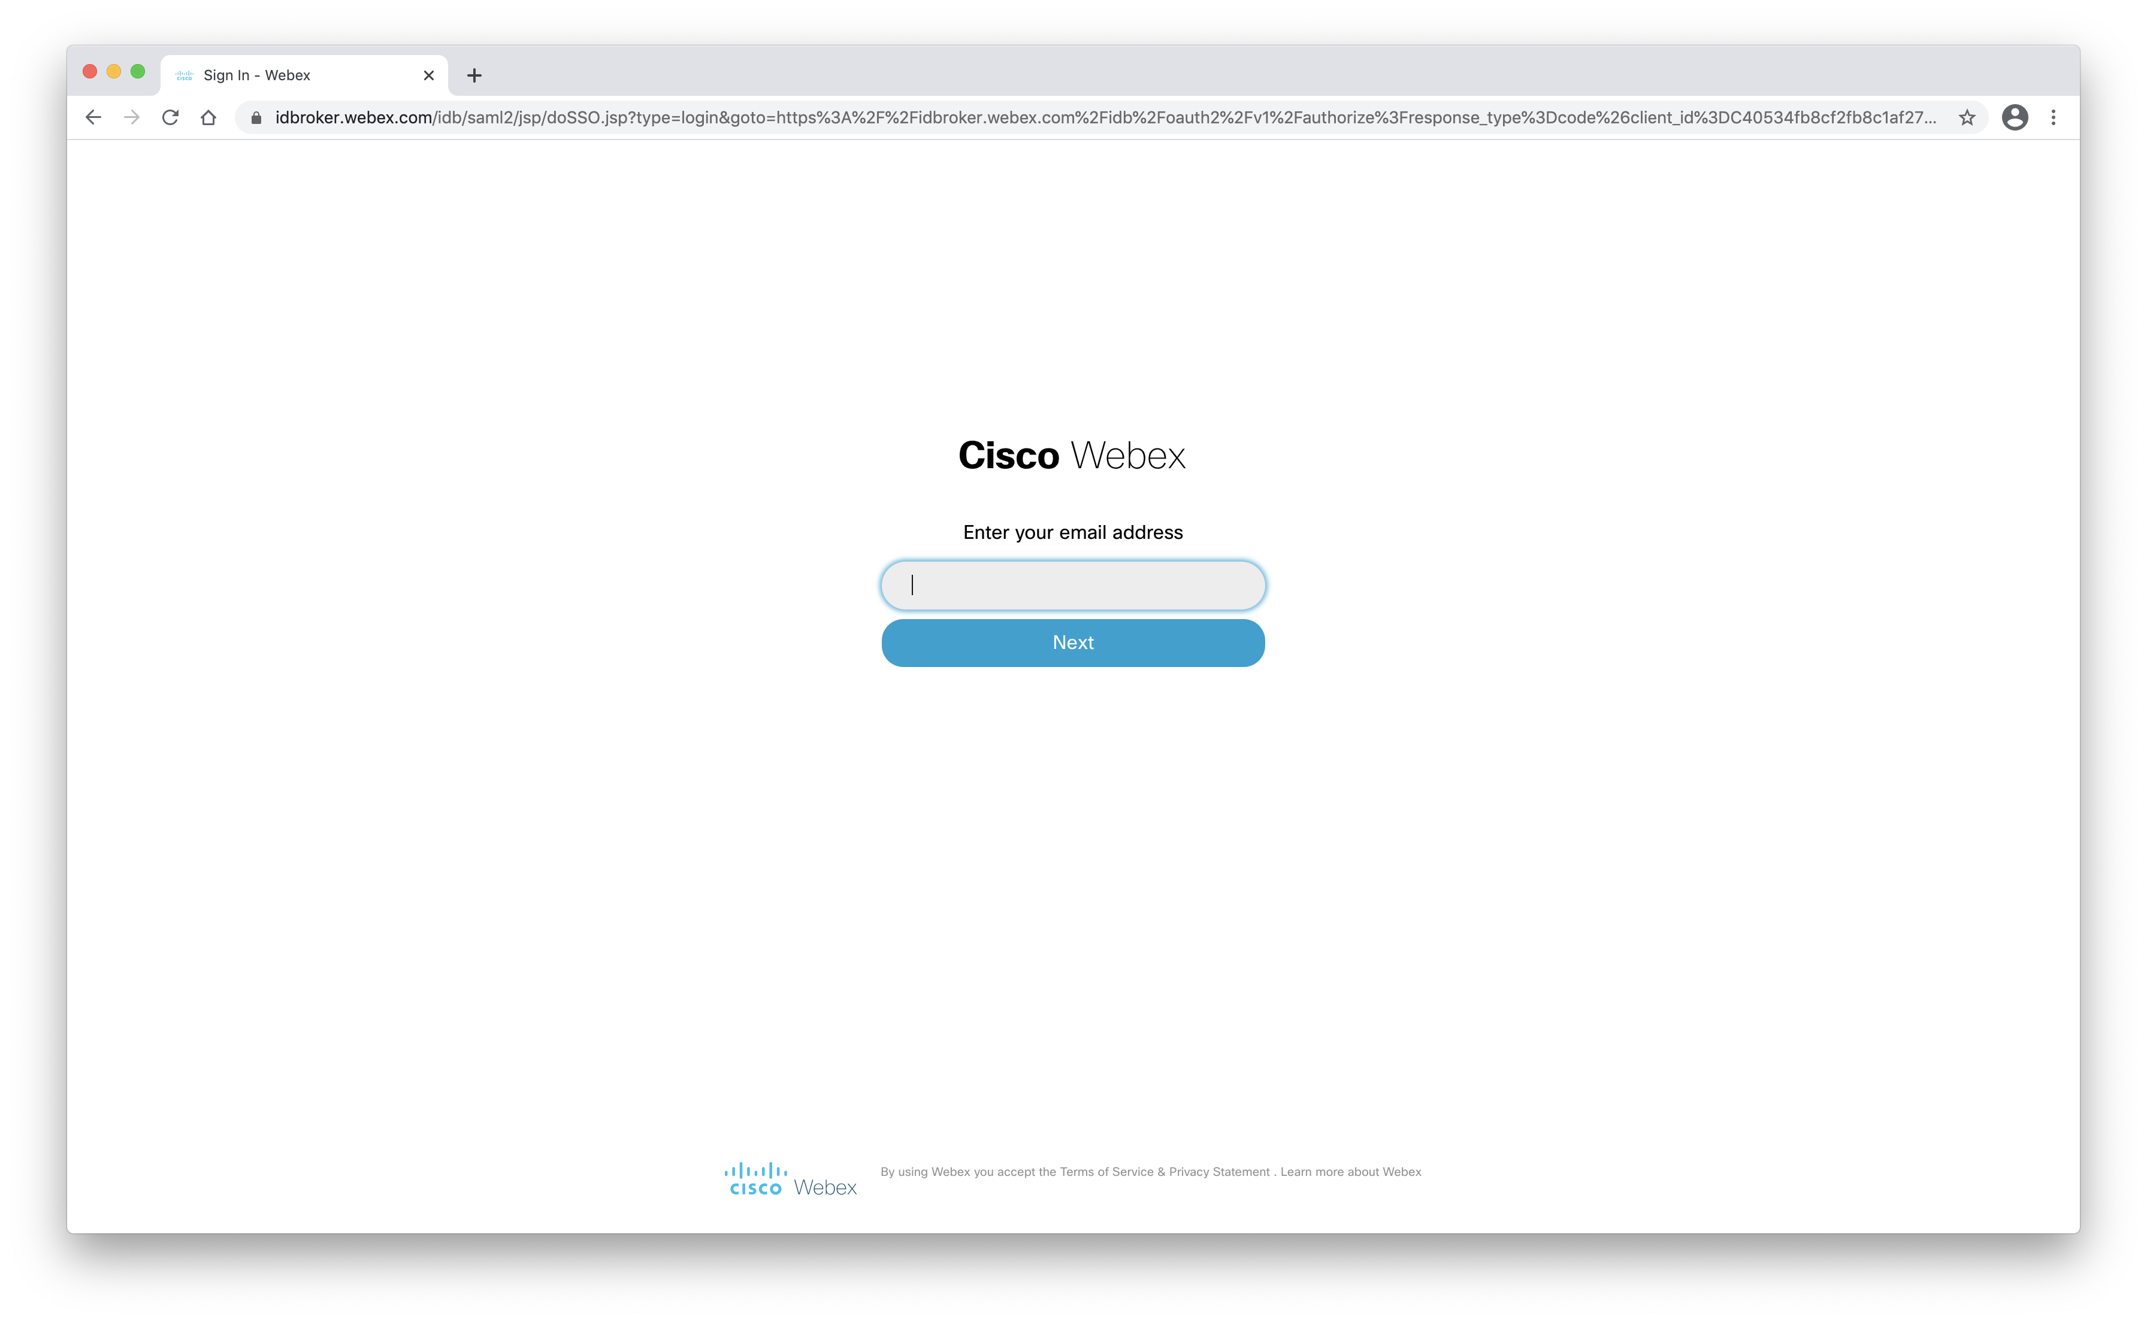
Out of the box, dbConnector will Cisco’s authentication server authenticating users.
Security has been implemented by using Spring Security.
You can swap out your authentication to fit your business policy

Slide 3
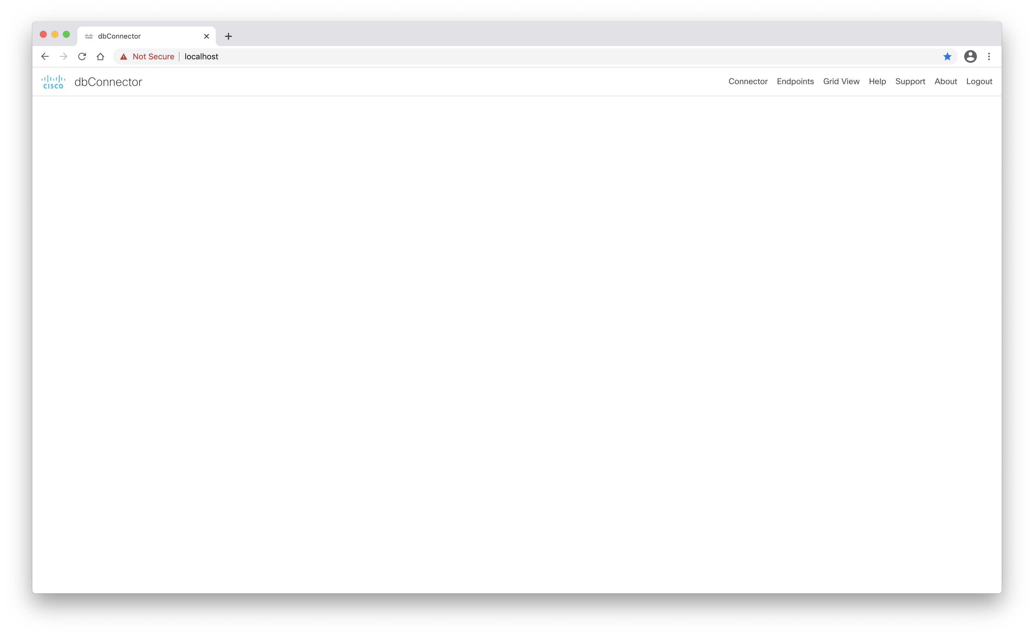
Home page for an authenticated user
Menu links
Connector – Define your database connection string and connection pool
Endpoints – Create your rest endpoints to be used by WebexCC
Gid View – Allows you to see the results of your endpoints
Help – A placeholder for you to update your help procedures.
Support – A placeholder for you to update your support procedures.
About – A placeholder for you to update as you see fit.
Logout – link to the logout page.

Slide 4
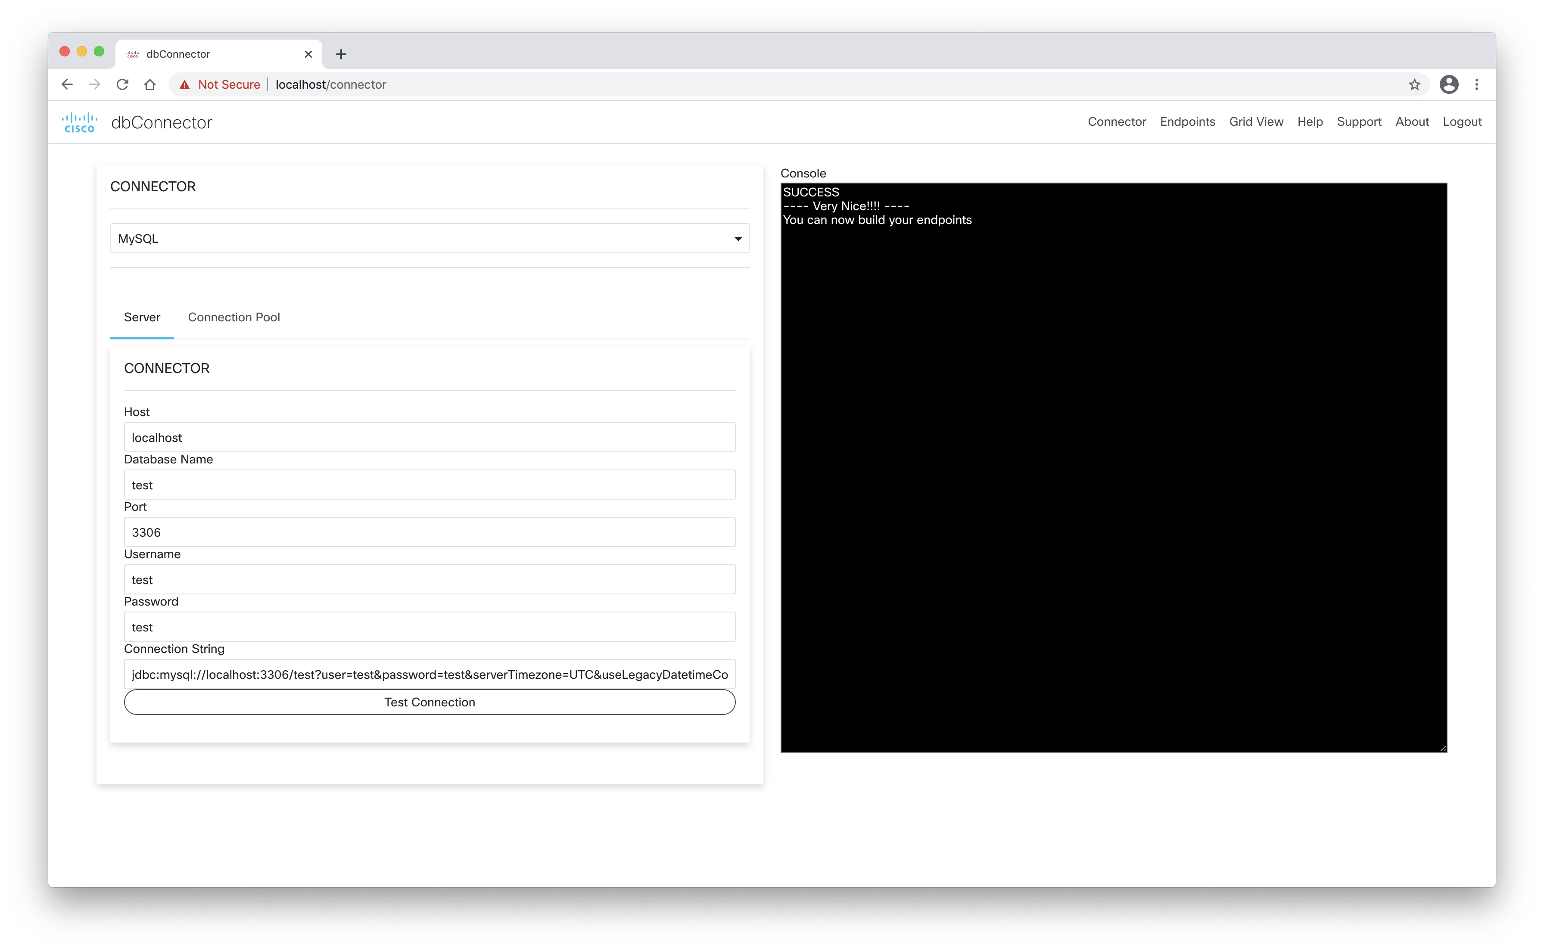
Use this page to define your database connection

Slide 5
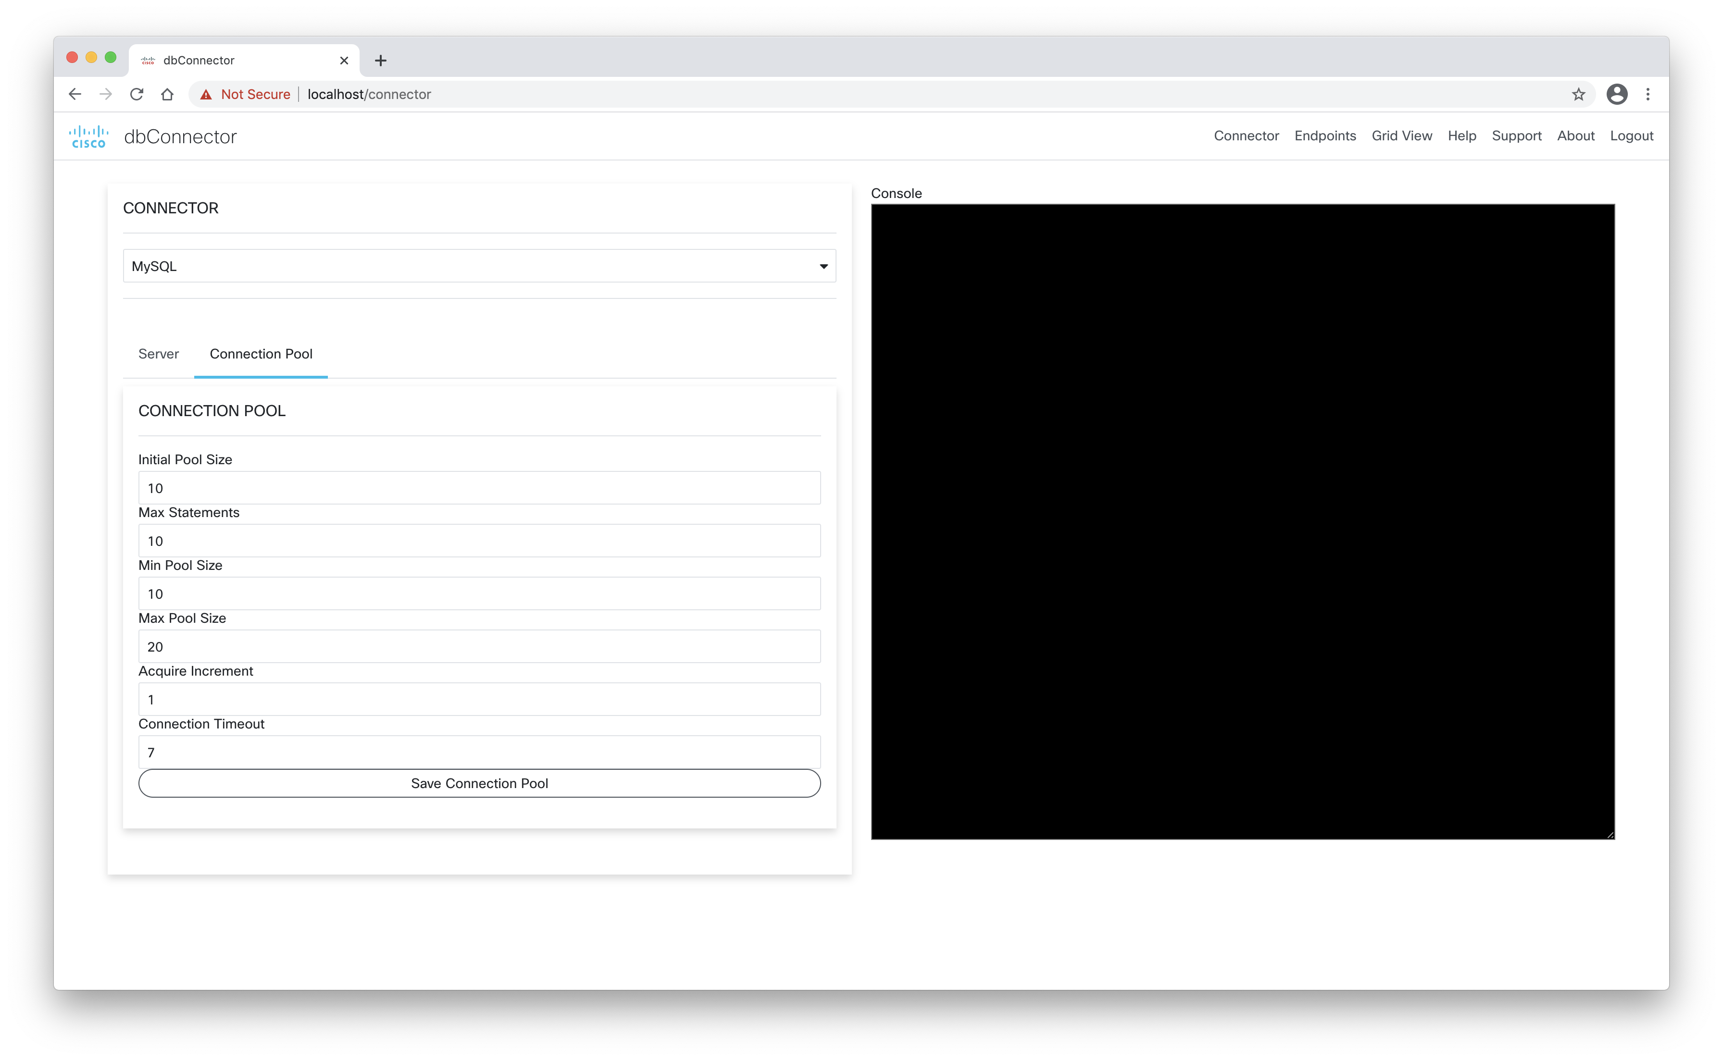
Use this page to tune your database connections

Slide 6
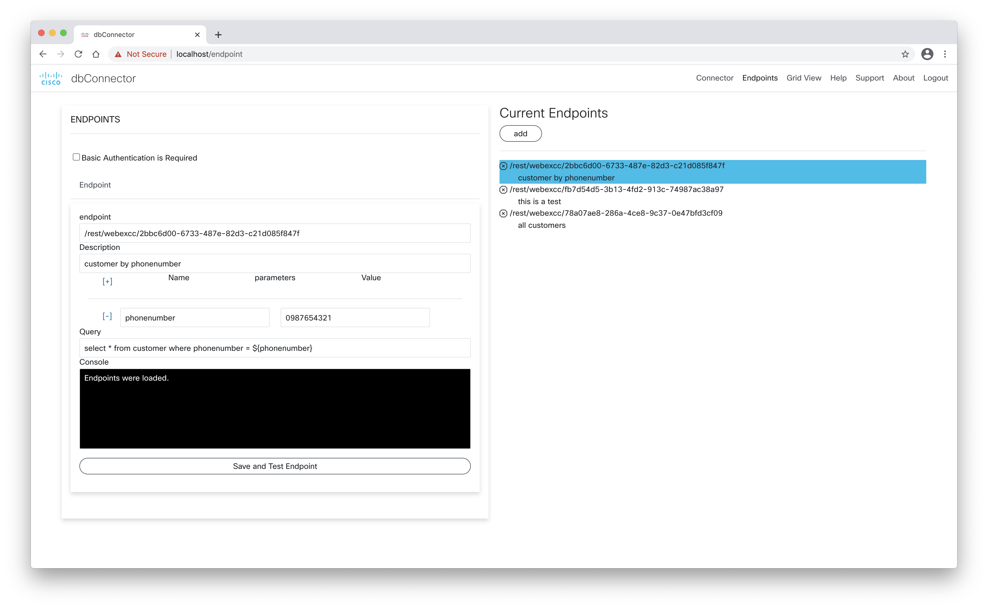
Basic Authentication user/pwd
Add name/value pair
Testing value
SQL statement and use ${} to refer dynamic data

Slide 7
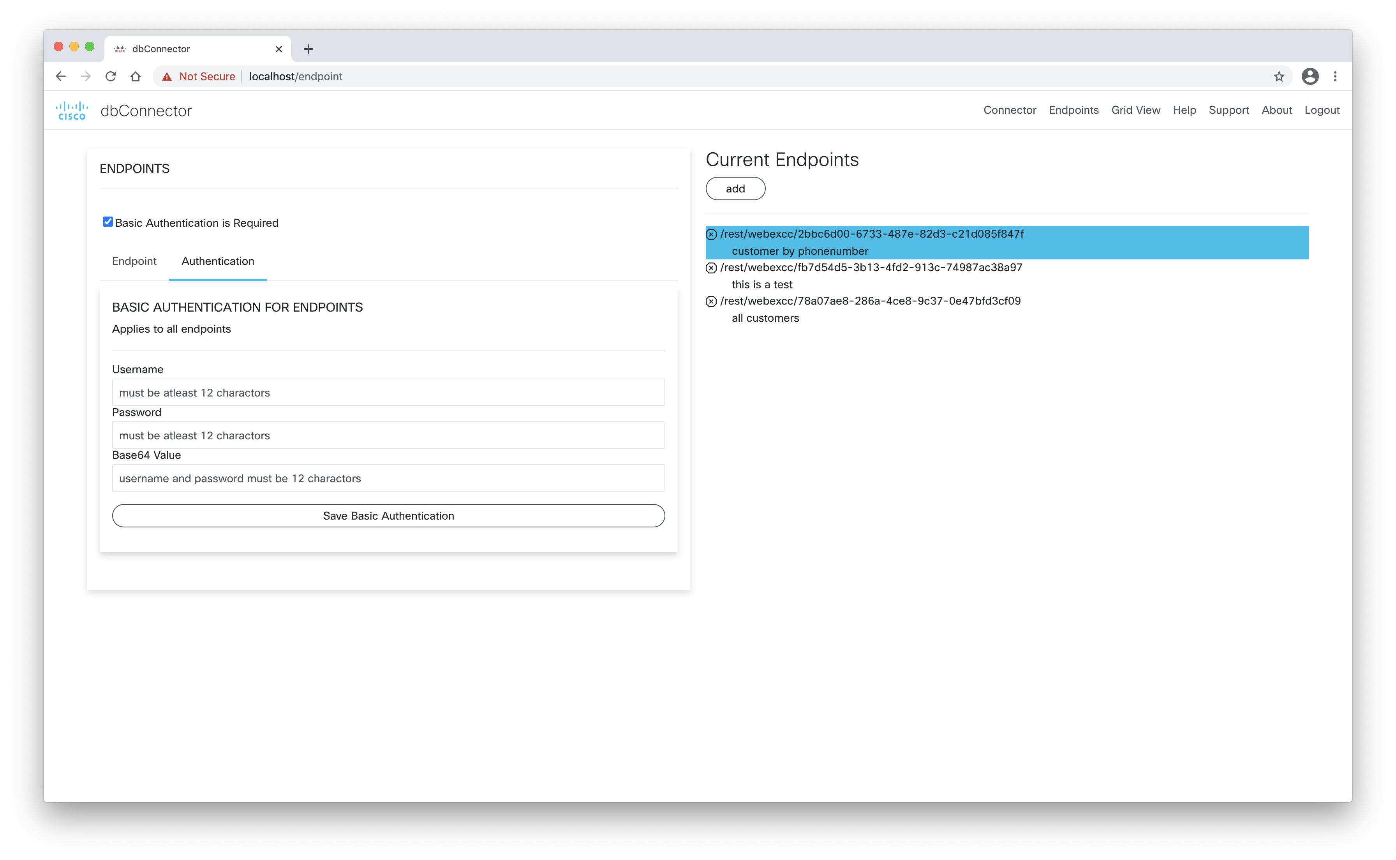
This apply to all endpoints

Slide 8
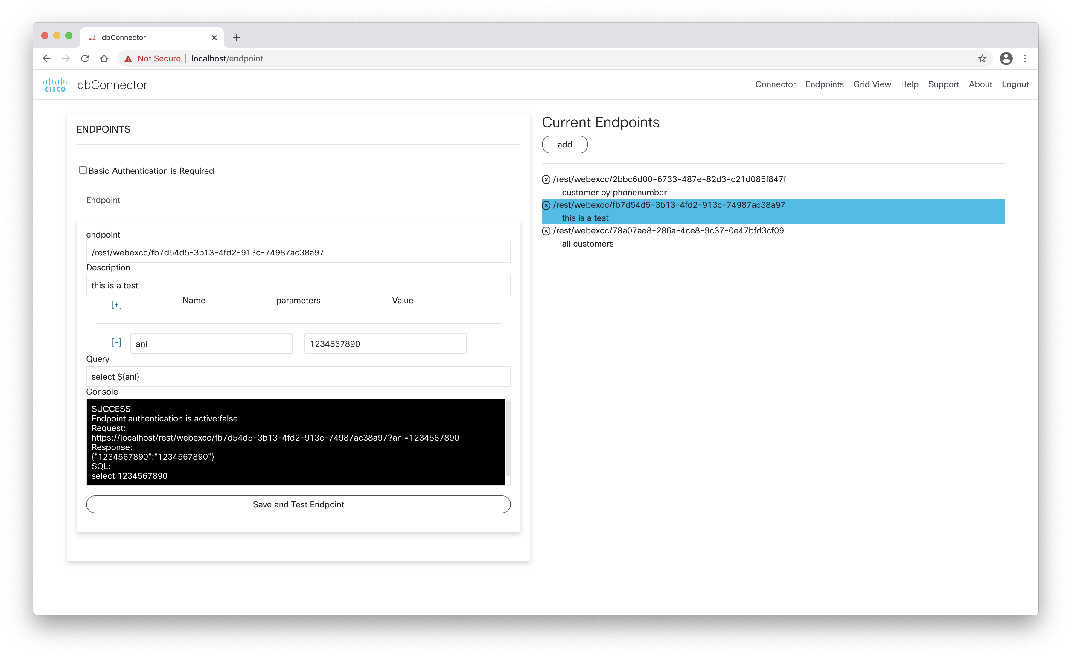
Here is your URL to use for WebexCC
Save and test will display the results of your query

Slide 9
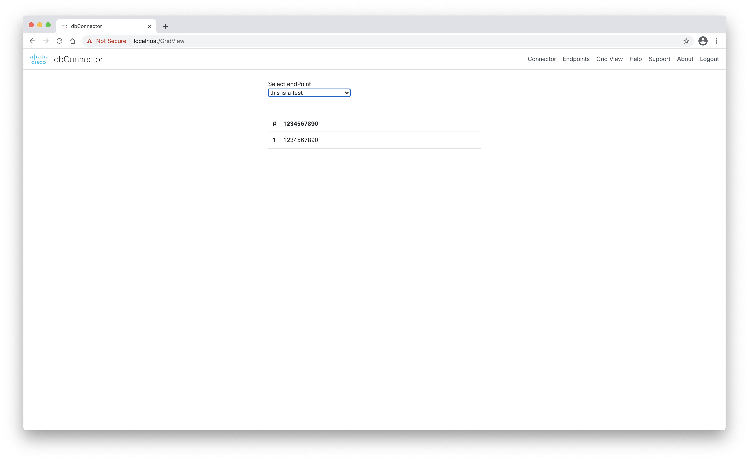
Endpoint description
Table list of your result(s)

Slide 10
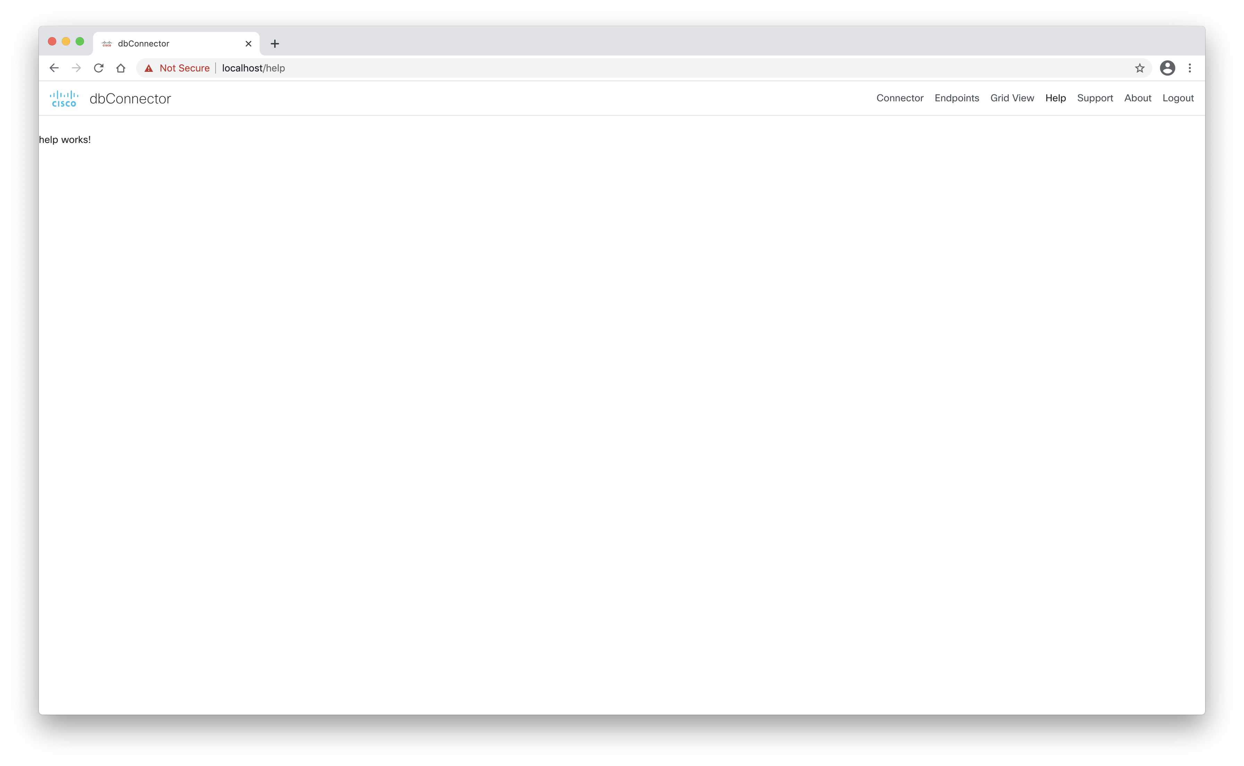
Add your own help page details

Slide 11

Add your own support page details

Slide 12

Add your own about page details

Slide 13
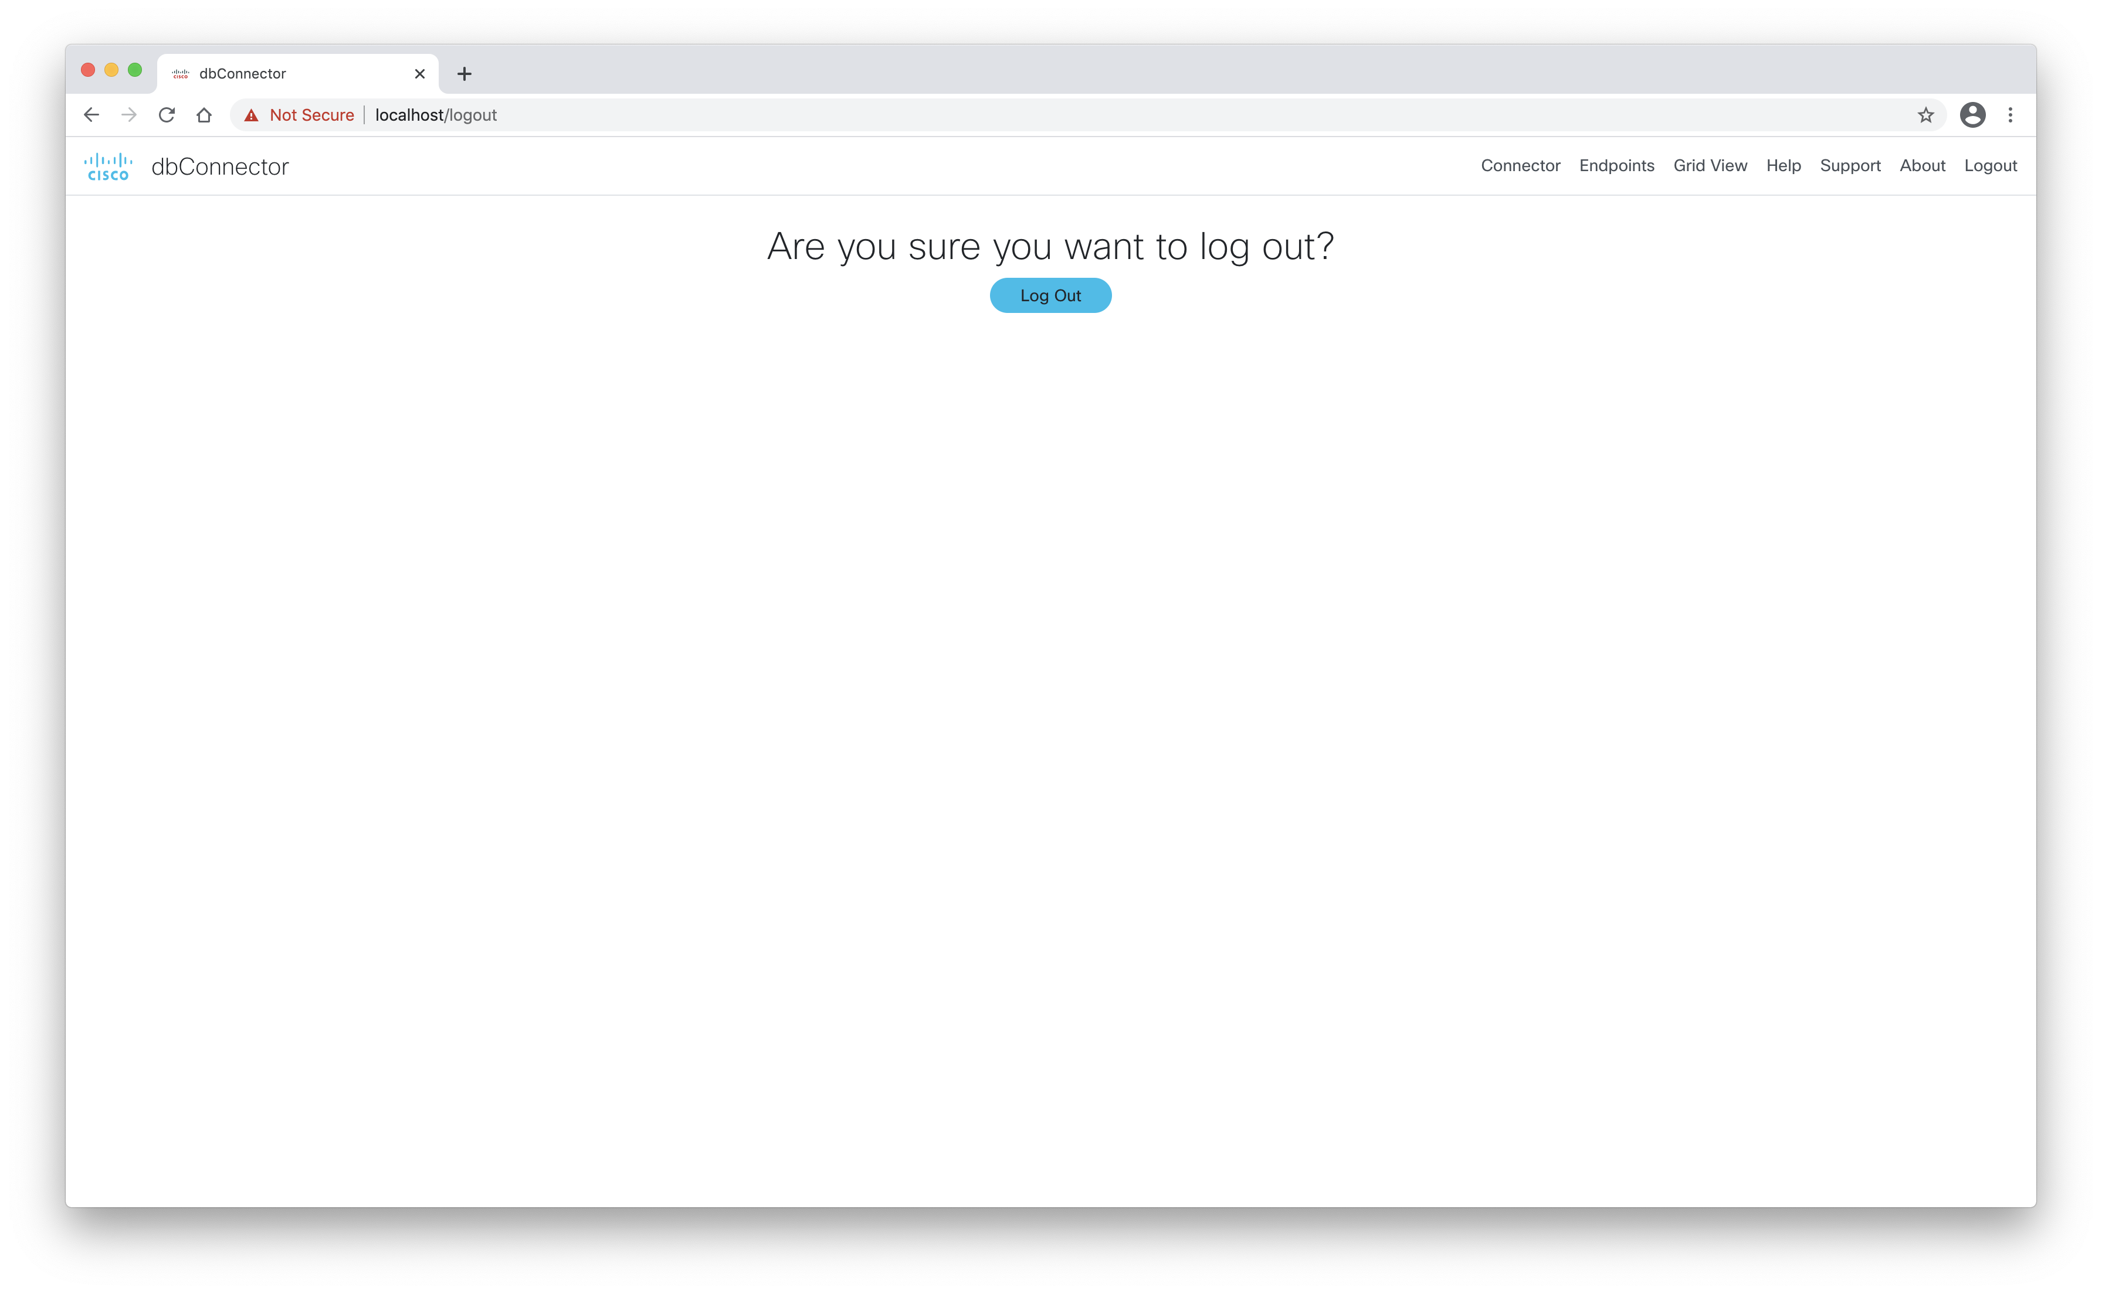
Logout screen

